Slide 1
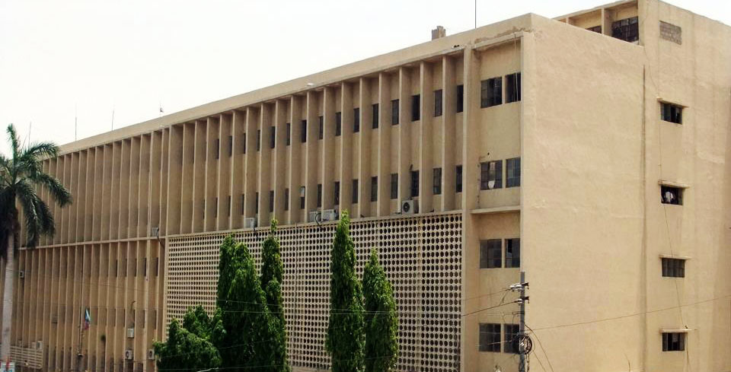

Functional English
Mr. Muhammad Hassan Abbasi
Lecturer English
PhD Scholar English Linguistics

Slide 2
Activity: Find Someone Who
Instructions:
Go around the class asking each other questions to find a person who fits one of the sentences.
When you find that person, write their name in the space provided.
Example to elicit questions: (Do you recover from illnesses very quickly? Do you often begin arguments with strangers?)
Do not have the same name written down more than two times.

Slide 3
Phrasal verbs
A verb that is made up of a main verb together with an adverb or a preposition, or both.
Example : Look after
They are more common in spoken English than in written English.
Lets learn some phrasal verbs related to the activity we have just completed

Slide 4
Task: Phrasal Verbs
Instructions
Match the phrasal verb to its equivalent meanings
Each phrasal verb is listed with some common collocations (words that go with other words)
Look at the activity worksheet for more help to understand the meanings.

Slide 5

Share some examples!
After matching, rewrite the completed sentences from the first worksheet using the phrasal verbs.

Slide 6
WHAT IS READING?
“Reading is an interactive, problem-solving process of making meaning from texts.” Literacy for Learning, The Report of the Expert Panel on Literacy in Grades 4 to 6 in Ontario, p. 61.

Slide 7
WHAT IS READING?
R e a d i n g i s a c o m p l e x i n t e r a c t i o n b e t w e e n t h e t e x t , t h e r e a d e r a n d
t h e p u r p o s e s f o r r e a d i n g , w h i c h a r e s h a p e d b y t h e r e a d e r ’ s p r i o r
k n o w l e d g e a n d e x p e r i e n c e s , t h e
r e a d e r ’ s k n o w l e d g e a b o u t r e a d i n g a n d w r i t i n g l a n g u a g e a n d t h e
r e a d e r ’ s l a n g u a g e c o m m u n i t y w h i c h i s c u l t u r a l l y a n d s o c i a l l y s i t u a t e d .

Slide 8





A transactive process
Involves complex negotiations between text and reader which is shaped by reader’s
Knowledge of topic
Purpose for reading
Language culturally expectations based on experiences

Slide 9


Aesthetic Reading
-Reading for enjoyment
Efferent Reading
-To gain information

Slide 10


There are 5 stages in the reading process:

Slide 11





Activate/build background knowledge
Set purposes for reading
Preview the text
(Tompkins, G.E. & Hoffner, H.)

Slide 12




There are 5 stages in the reading process:

Slide 13



Read independently, with a buddy, using shared reading, guided reading, or listen to the text read aloud
Read the entire text from beginning to end or read one or more sections to learn specific information
Apply strategies and skills
Read the illustrations, charts, and
diagrams
(Tompkins, G.E. & Hoffner, H.)

Slide 14




Slide 15


Respond in reading logs
Discuss the text with
classmates and teacher
(Tompkins, G.E. & Hoffner, H.)

Slide 16



Slide 17

Reread and think more deeply about the text
Examine the author’s craft
Learn vocabulary words
Participate in minilessons
(Tompkins, G.E. & Hoffner, H.)

Slide 18




Slide 19

Create a project
Connect with related books
Value the reading experience
(Tompkins, G.E. & Hoffner, H.)

Slide 20
Reading Text
Reading Text about Celebrities

Slide 21
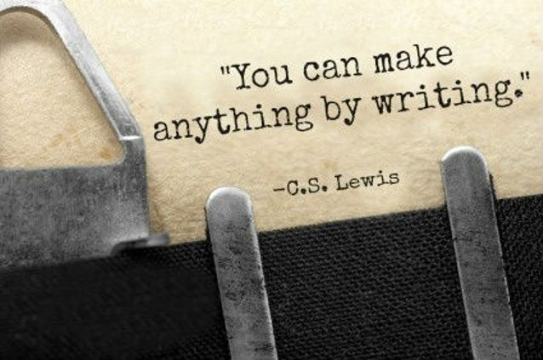

Slide 22









The Writing Process
Steps in Writing an Essay
Revising and Editing
Pre-
Writing
Drafting
Final Draft!
Planning and Organizing

Slide 23
Introduction
What is the Writing process ?
Writing an essay takes time.
That’s why writing is Often referred to as a process.
In other words, there are several steps to go through before you have a complete essay ready to turn in.
In this lesson we will talk about those steps. They are:
Pre-Writing
Planning
Drafting
Revising and Editing

Slide 24

Pre-Writing Strategies

Slide 25


Pre-Writing
Step One
Pre-writing literally means, “before writing.”
Before you actually begin writing your essay, you will need to do the following things:
Choose a topic to write on
Brainstorm or generate ideas for your topic
Focus on central ideas

Slide 26
Pre-Writing
First stage of the writing process
Helps us discover our initial ideas about a subject and put them on paper, though not usually in organized form

Slide 27
Common Pre-Writing Strategies
Free writing
Brainstorming
Listing
Clustering/Mapping
Journalistic Questions
Outlining

Slide 28
1. Freewriting
Jotting down all ideas on a particular topic on paper even before researching about it.
Does not require complete sentences, proper spelling, or correct punctuation and grammar.
About 10 to 15 minutes to write everything that comes to mind even if it doesn’t necessarily make sense yet.

Slide 29
Freewriting
Example (Free writing of a student who needs to write a paper about the environment):
I have to write a paper about the environment. I have no idea where to start! I know there are many problems with the environment, but I don’t know much about this topic. Maybe I could take a look at my biology book to come up with some ideas. I know my biology professor is also really into the environment, so maybe I could ask for his help. I remember he was talking about hybrid cars in class the other day and how much better those are for the environment. What is a hybrid car? I know it uses some sort of alternative fuel and they are becoming very popular. Maybe that is something I could write about…

Slide 30
Free Writing: Sample 2
The literacy rate in Pakistan is 60%. It means that 40% people are illiterate. In rural areas, people are un-educated because they are in pursuance of their livelihood instead of getting education in schools. our country is slow towards progress. Illiterate people do not know how to react on things. The most common cause of illiteracy is that education is not considered a priority. There is no job for un-educated people. That is why the crime ratio is high in our society due to illiteracy. Rural people face problems for employment because they are totally un-educated. Government should also take steps to establish schools and colleges in villages so that children who are living in villages may not travel to cities to get education.
Illiteracy is a big problem because the illiterate people are unable to understand the new techniques of social life. They do not enjoy the life. They do not understand the new policies. Every individual has right to get education in better institutions. Illiteracy minimizes the social relations in the society which leads to less development of resources. Illiterate person is unable to read books, magazine, articles, and other reading materials.

Slide 31

Writing on a Topic
Take 5 mins and write on a topic ‘Celebrities’ without any pause.
No need to consider spelling or grammatical errors.
Just continue writing.

Slide 32

2. Brainstorming
Jotting down ideas
Words
Phrases
Clauses
Sentences
Visual Aids

Slide 33

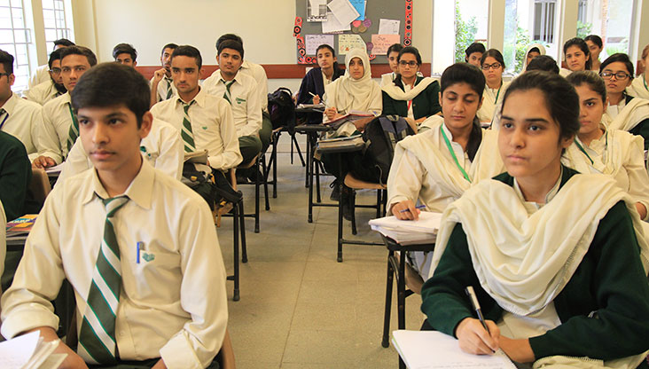
Why is the Sky Blue ?
One thing you would change about school.

Slide 34
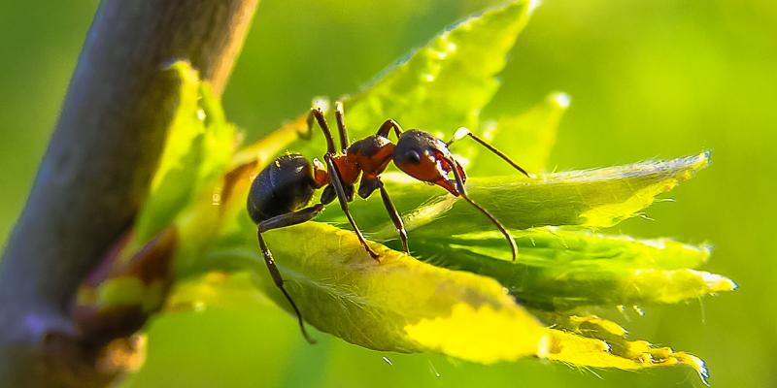
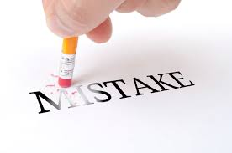
Pretend you are ant. Write about your view of the world.
One mistake you have made in your life.

Slide 35
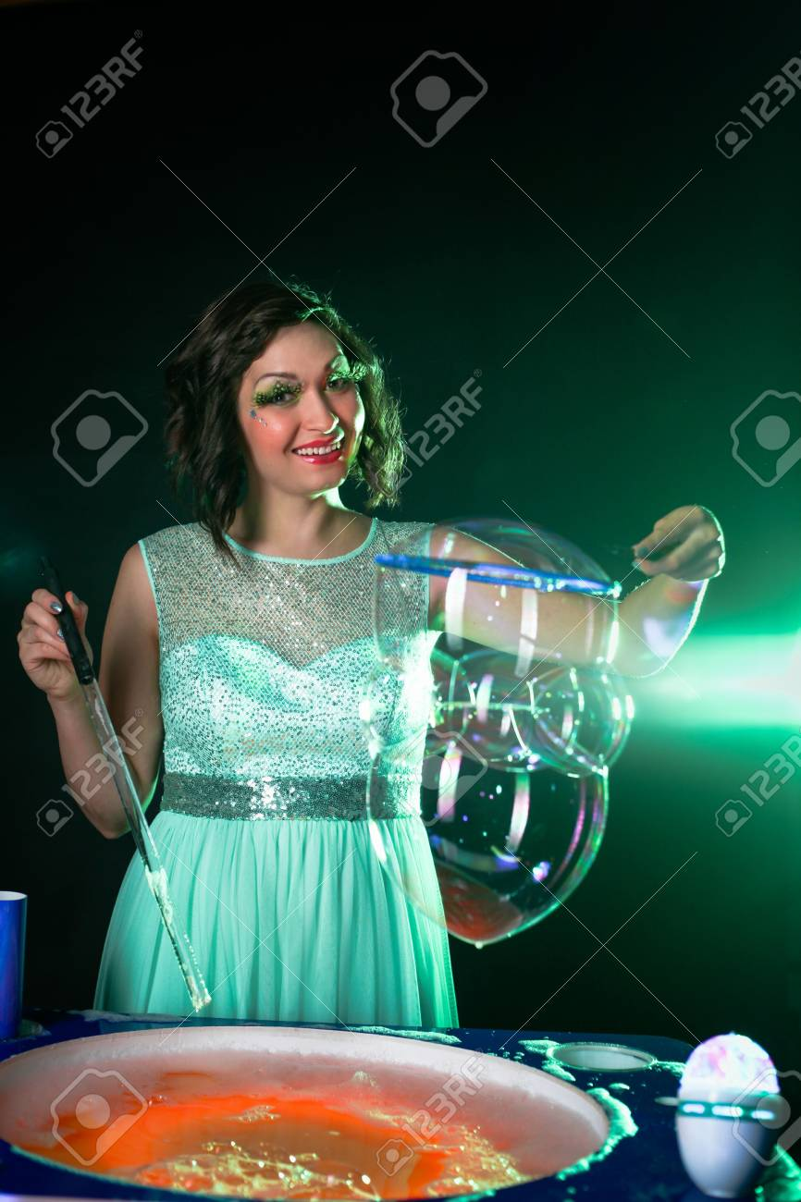
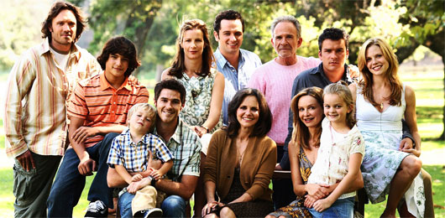
You just found a magic wand. Write about what you would do with it ?
What would it be like to have 10 brothers and sisters ?

Slide 36


What would you do if you saw someone being bullied ?
If you could go anywhere around the world, where would you go and why ?

Slide 37

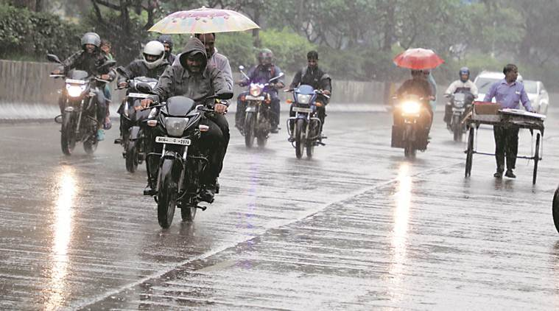
Do you like rain ?
Do you like Surprises ?

Slide 38

3. Listing
Capturing all thoughts, ideas, and fragments in one’s head and writing them down on paper
Similar to freewriting, but:
Freewriting = Paragraph
Listing=Jot down
ideas in form
a list

Slide 39
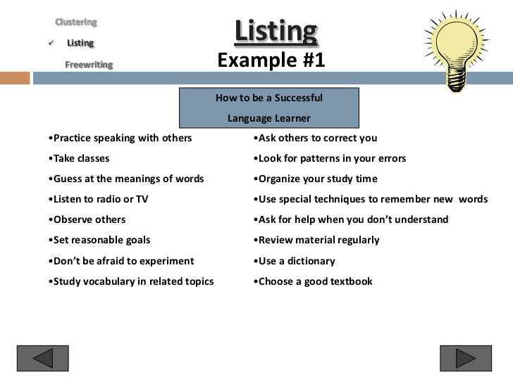
Listing
Example (Listing of a student who needs to write an essay on ‘How to be a successful language learner):

Slide 40
4. Clustering/Mind mapping
Clustering /Mind mapping is a strategy that allows you to explore the relationships between ideas.

Slide 41
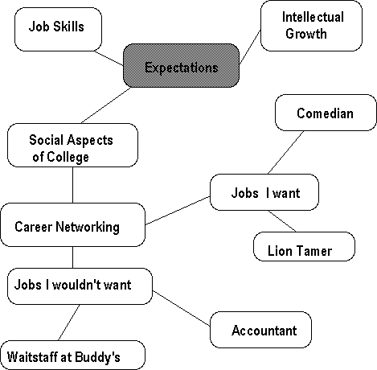
Clustering
Example (Clustering of a student who needs to write an essay on the value of a college education)

Slide 42
Mapping :Social Media : Blessing or Curse
Curse
Less Family Time
Isolation
Mental Issues
Toxic /Stress
Draining energy
Artificial
Blessing
Connectivity with the world
Information
Online Education
Business
Awareness

Slide 43
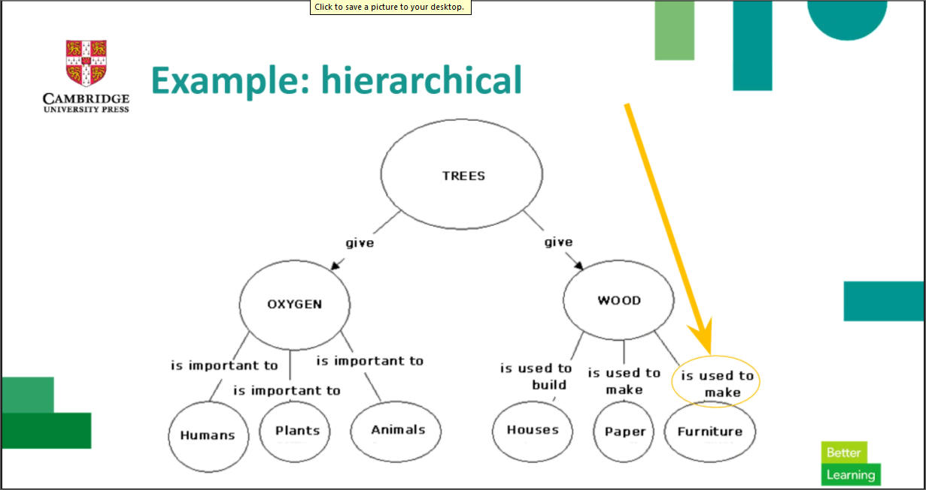
CONCEPT MAPPING

Slide 44
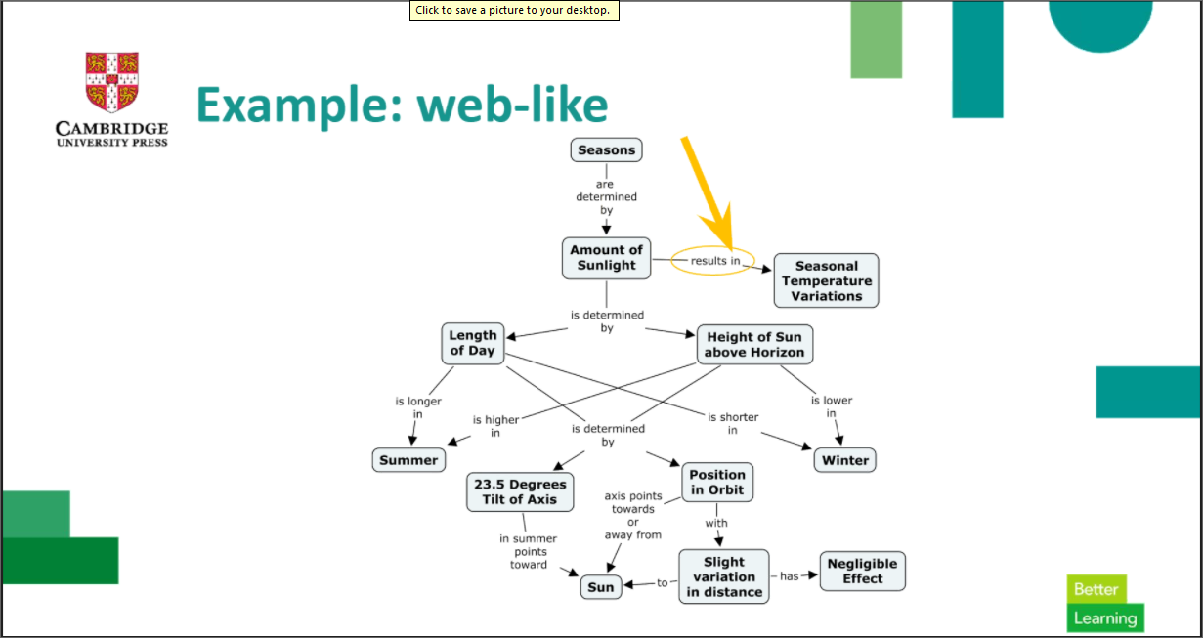

Slide 45
Journalistic Questions
Example (Questions of a student who needs to write a report on the political conflict in the Middle East):
Who is involved in the conflict?
What issues most clearly divide those engaged in this dispute?
When did the troubles in the Middle East begin, and how have they developed over time?
Where does the conflict seem most heated or violent?
Why have those living in this area found it so difficult to resolve the situation?
How might this conflict be resolved?

